Slide 1
RETINAL BLOOD VESSEL SEGMENTATION USING MATCHED FILTER
GUIDED BY-
R MANJUNATHA
By:
SHEKHAR
CHANDAN
GANESH
HEMANTH

Slide 2
ABSTRACT
Automatic retinal blood vessel segmentation algorithms provides useful information for the diagnosis and monitoring of eye diseases such as diabetic retinopathy, hypertension, glaucoma etc.
Many of the methods in a variety of edge detection algorithms do not always lead to acceptable results in extracting various features in an image. The concepts of matched filtering is used to detect piecewise linear segments of blood vessels in these images. Generally we construct different templates that are used to search for vessel segments along all possible directions.
All these templates are combined to get a accurate segmented vessel structure

Slide 3
INTRODUCTION
Retinal images have been widely used for diagnosing vascular and non-vascular pathology in medical image processing.
Retinal images provide information on the changes in retinal vascular structure, which are common in diseases such as diabetes, glaucoma, hypertension, cardiovascular disease and strokes.
Automatic segmentation of retinal blood vessels from retinal images would be a powerful tool for medical diagnostics.
The main aim of segmentation is to differentiate an object of interest and the background from an image.

Slide 4
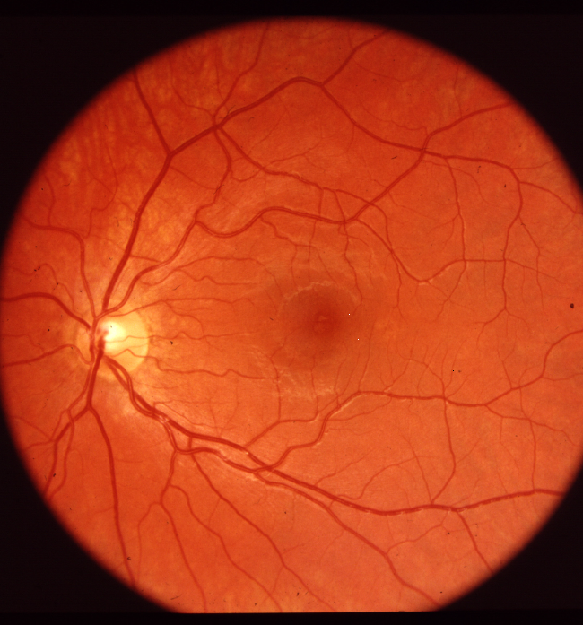
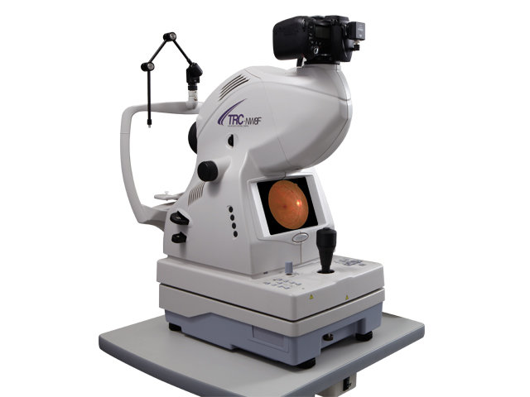
Fundus photography:
Fundus camera
Fundus image

Slide 5
PROPOSED METHODOLOGIES
The blood vessels usually have a very low contrast so different methods are proposed to get an accurate segmentation.
Different authors have categorized vessel segmentation into different methods.
Among them, the highly used method is pattern recognition.
Pattern recognition is divided as supervised and unsupervised based on the method of classification.

Slide 6
Continued….
Now, retinal vessel segmentation techniques are classified into 7 categories.
(1) Pattern recognition
(2) Matched filtering
(3)Mathematical morphology
(4) Multi-scale approaches
(5) Vessel tracking
(6) Model based approaches
(7) Parallel/hardware based approaches

Slide 7
Matched filter:
According to Chaudhuri et al. , the two dimensional Gaussian matched filter can be expressed as: 𝑓(𝑥, 𝑦) = − 𝑒𝑥𝑝 (− 𝑥 ²/ 2𝜎² ) ∀ |𝑦| ≤ 𝐿/2
where 𝜎 is the scale of the filter or the spread of the intensity profile and 𝐿 is the length of the vessel segment having the same orientation
The kernel is rotated along 12 possible directions by 15 degree steps to form 12 different templates because the vessels can be oriented in any direction
A retinal image is convolved individually by each of the 12 kernels with different orientations and, from the set of these 12 output images, the maximum value for each pixel (x,y) is selected to form the matched filter response image

Slide 8
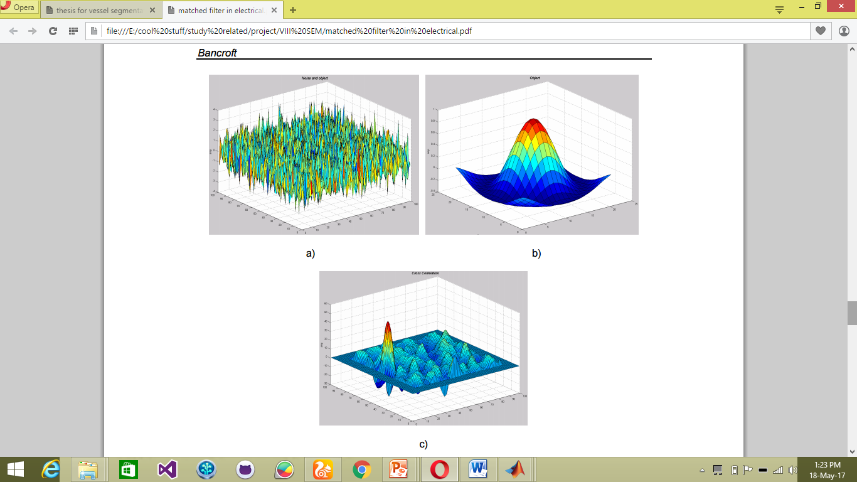
CONCEPTOF MATCHED FILTER:
Fig a. shows the noisy input.
b. shows the object to be detected
c. cross correlation of a and b where the object has been detected as the highest peak

Slide 9
WHY MATCHED FILTER:
According to Chaudhari et al., retinal blood vessels possess three different characteristics:
● The blood vessels have small curvatures and may be approximated by piecewise linear segmentation. ● The width of blood vessel decreases when moving away from the optic disk. ● Due to lower reflectance of vessels in comparison to other retinal structures, they seem to be darker compared to the background.
Using matched filtering, image’s features can be detected, which are most similar to a predefined template (which we term as KERNEL). Matched filter (MF) has ability to respond to both the vessels’ and non-vessels’ edges

Slide 10
Equation explanation:
f(𝑥, 𝑦) = − 𝑒𝑥𝑝 (− 𝑥 ²/ 2𝜎² )
It’s a probability function, which yields probability value (i.e. ranges from 0-1).
The range of X is the sub space and exp(x²) gives the mean square value of the total distribution
𝜎² is the variance which divides the mean square value to give out their probability distribution

Slide 11
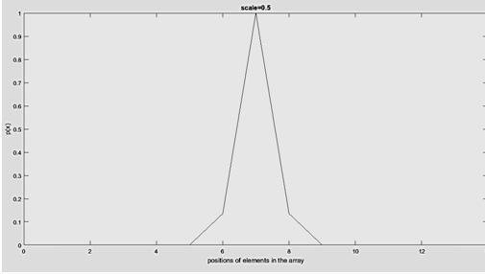
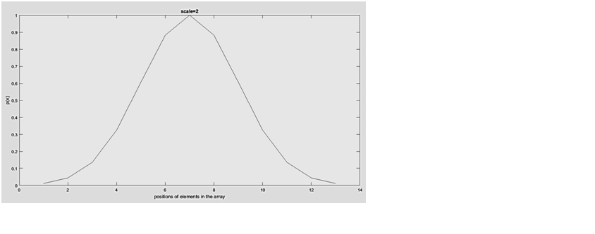

Slide 12
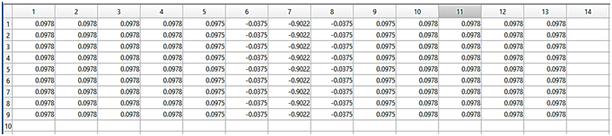
kernel creation
kernel matrix

Slide 13
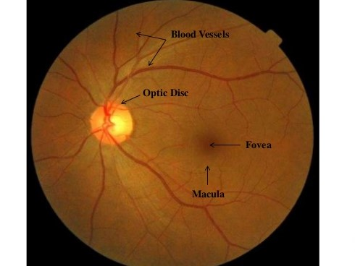
SEGMENTATION
The retinal vasculature is composed of arteries and veins appearing as elongated features, with their tributaries visible within the retinal image.
There is a wide range of vessel widths ranging from 1-20 pixels.

Slide 14
Continued....
Other structures appearing in ocular fundus image include the retina boundary, the optic disc, and pathologies in the form of cotton wool spots, bright and dark lesions.
The orientation and grey level of a vessel does not change abruptly; they are locally linear and gradually change in intensity along their lengths.
The vessels can be expected to be connected and, in the retina, form a binary tree-like structure. However, the shape, size and local grey level of blood vessels can vary hugely and some background features may have similar attributes to vessels

Slide 15
Improvisation techniques:
The retinal image usually has imperfections like poor contrast and noise, which need to be reduced or eliminated before extracting pixels’ features for classification
Often, the green channel of an RGB (red/green/blue) image is extracted because it provides better vessel-background contrast than red or blue channels, and can thus be used for identifying blood vessels from retinal images

Slide 16
Continued..
In order to remove the noise and jitters in an image , wavelet transformation is used which also results in the data compression. so to overcome this compression of data inverse transformation is done
Thinning of an image

Slide 17
APPLICATIONS
Glaucoma disease is characterized by changes in the eye ground in the region of the optic nerve head:
(i) enlargement of the excavation
(ii) disc hemorrhage
(iii) thinning of the neuro-retinal rim
(iv) loss of retina nerve fibers
Diabetics is characterized by hemorrhages (which leads to change in tortuosity and diameter) and can be detected using density analysis of the segmented retinal images.

Slide 18
Continued…
Premature birth cases are characterized by inappropriate and disorganized retinal vessels. Here, the blood vessels become dilated with tortuosity as of serpentine paths. High blood flow and increased congestion of vessels are observed.
Study of macula is used for the detection of many macular diseases by opthomologists.

Slide 19
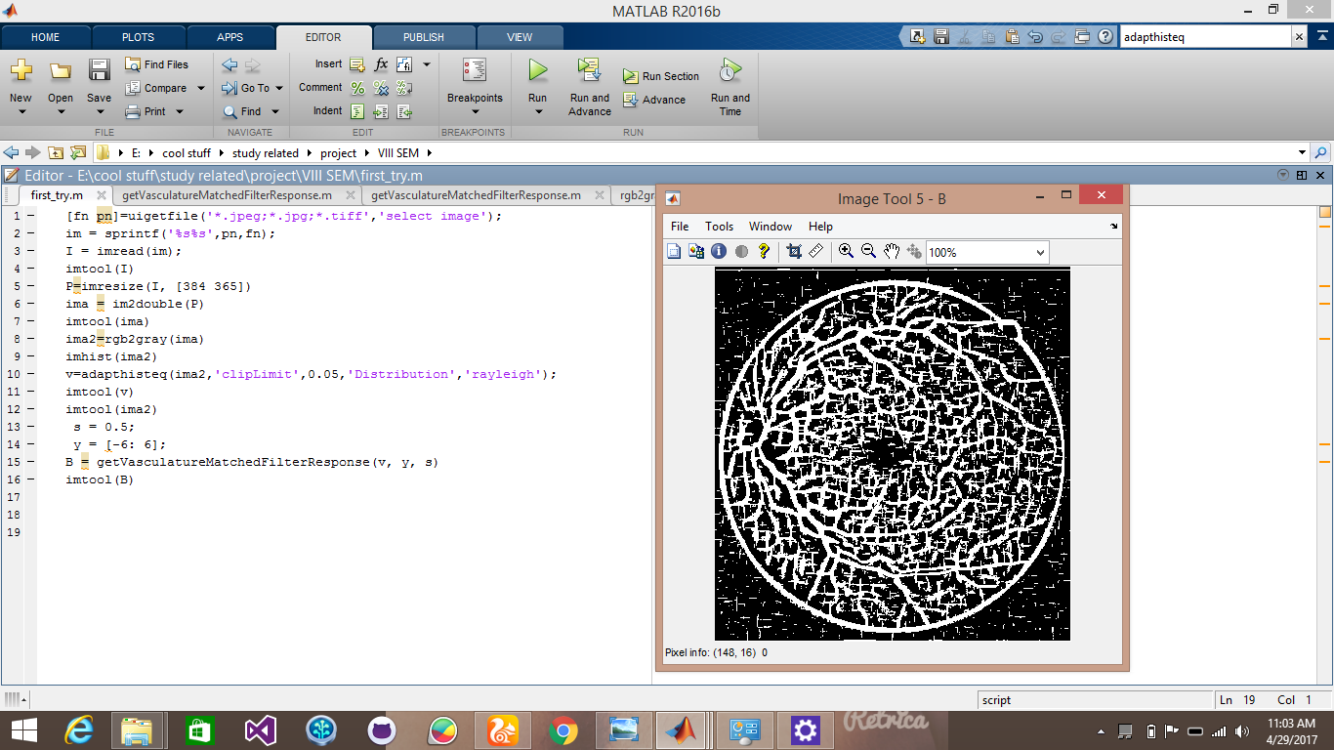
SUMMARY OF OUR WORK
Our first good output:

Slide 20
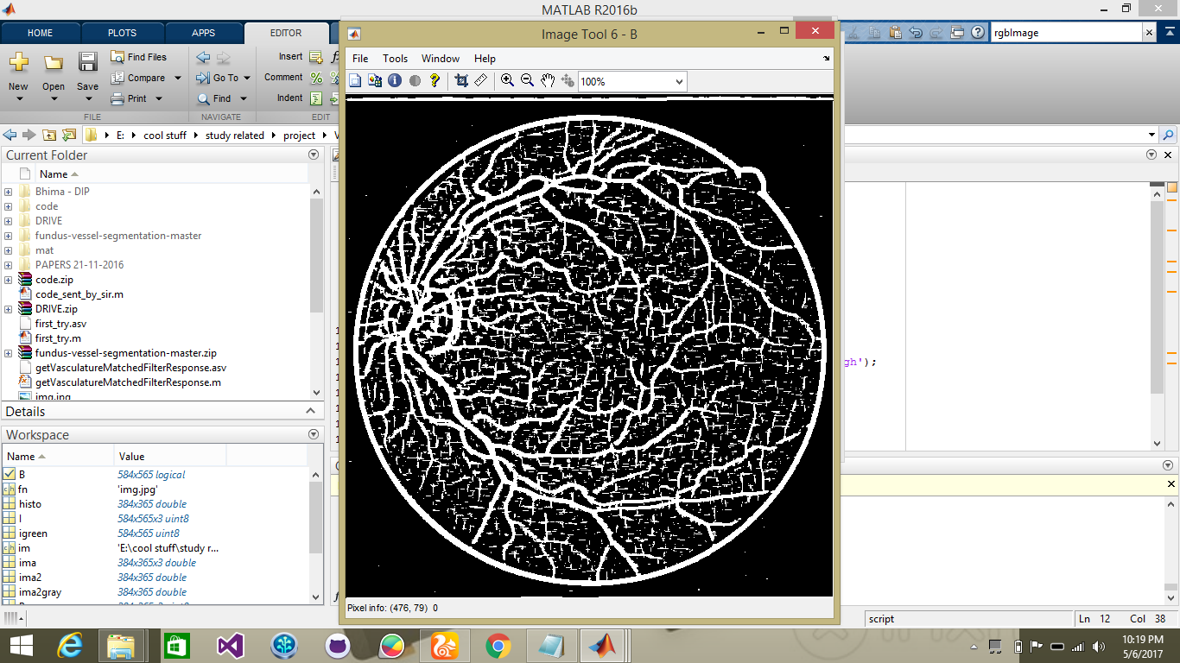
Trying to improvise using green channel:

Slide 21
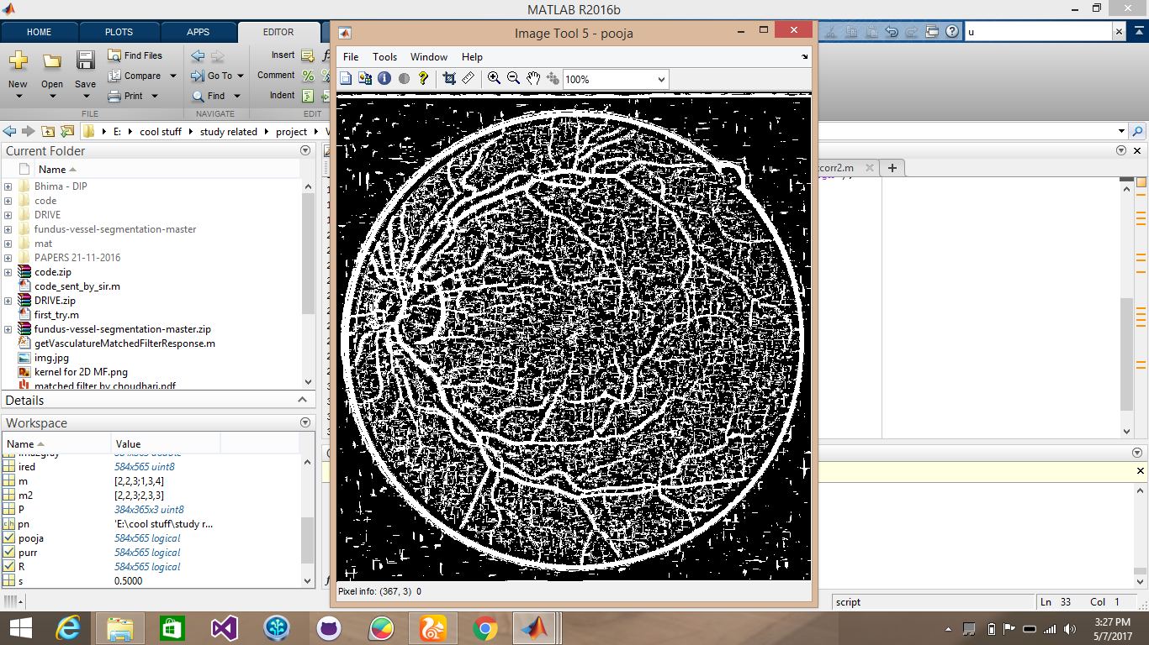
Applied xor between the three channels of image:

Slide 22
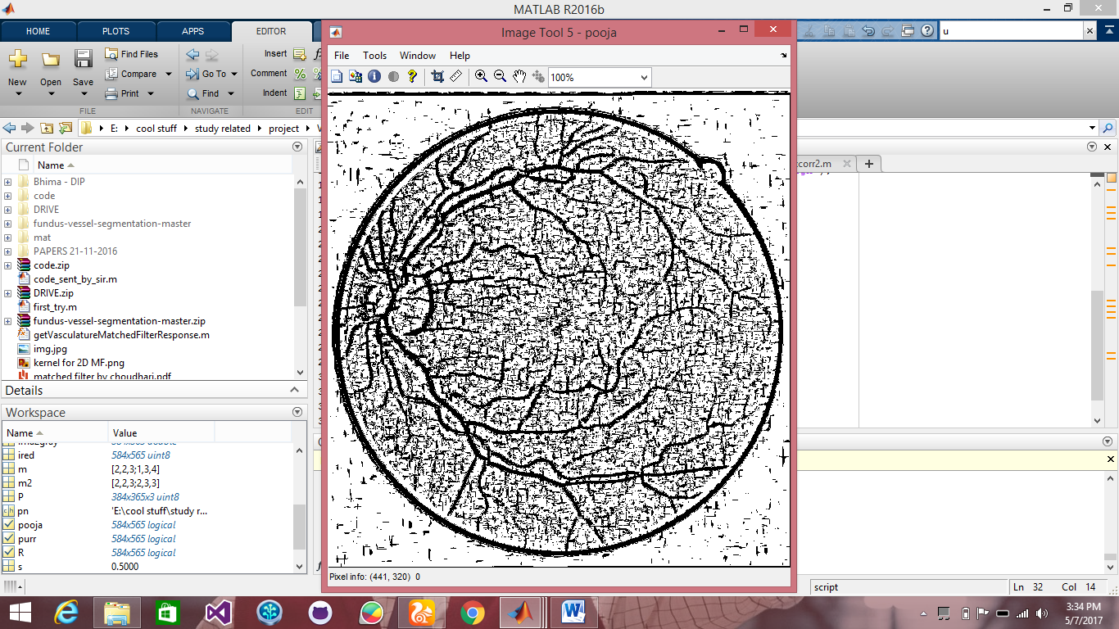
Applied xor between the r and b channel image and then xnor with the g channel image:

Slide 23
Future works:
We have planned of a possible modification to our project.

Slide 24
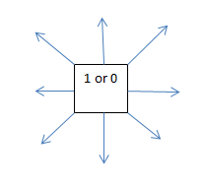
Continued…
A structuring element will start at any arbitrary point and will go on tracing the curves using the graph theory concept of neighboring pixels which is similar to 8-point connectivity in Image Processing. With this the system should be able to trace out the distance the structuring element has traced out.
This is similar to the google maps when it traces our destination path from the starting point,

Slide 25
References:
www.ietdl.org
“Retinal vessel segmentation by imporved matched filtering”
- Jan Odstricilik, Radim kolar, Attila Budar.
IEEE Trascation Medical Imaging:
“Detection of Blood vessel in Retinal Images using Two-dimensional Matched Filter”
- Subhasis Chaudhuri, Shankar Chatterjii, Norman Katz.
Blood Vessel Segmentation from Retinal Images:
- Anil Maharjan

